Slide 1
nixWRehosT: Rehosting NixOS Firmware
Winston White
Penn State College of Information Sciences and Technology

Slide 2
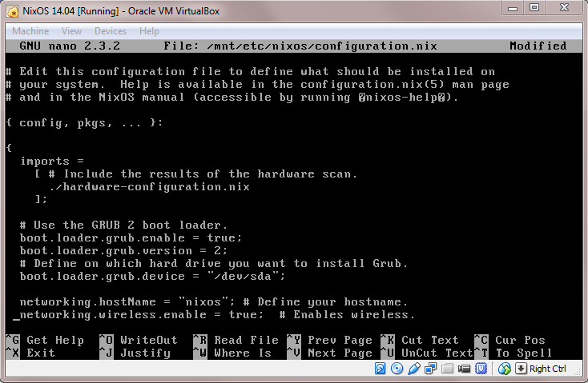
Recap on NixOS
NixOS is a newer open-source operating system based around reproducibility
  No imperative commands
    sudo apt install
Uses Linux kernel, but breaks many userspace expectations
  Not compliant with Filesystem Hierarchy Standard (FHS)
  Extremely symlink-based
  All packages and configurations installed to /nix/store/

Slide 3
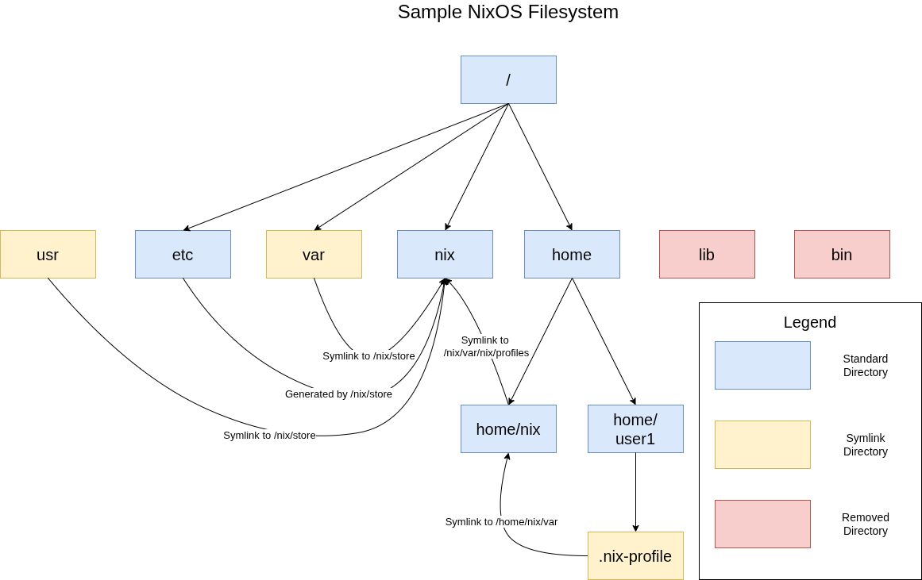

Slide 4
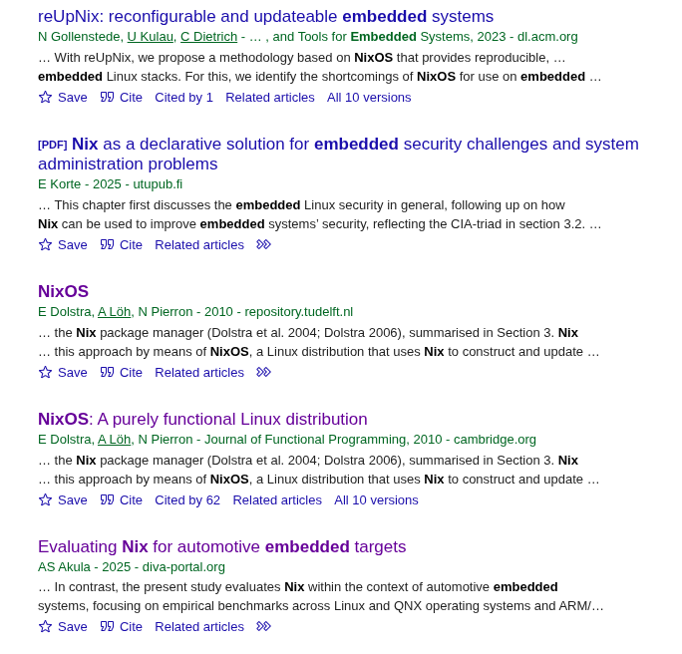
Literature Review: Embedded NixOS
Not very popular in academia, I only found 5 papers in total
    Even Deep Research couldn’t find more
Most have closed-source code, not published with paper

Slide 5
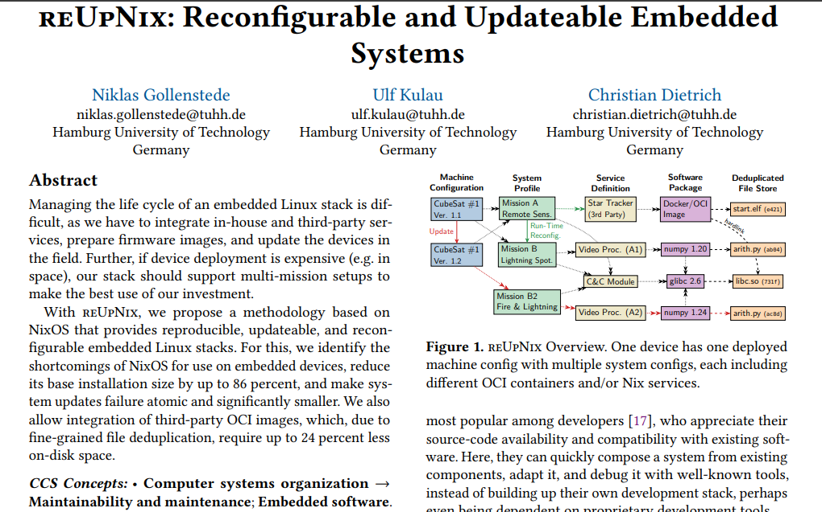
reUpNix — Hamburg University of Technology

Slide 6
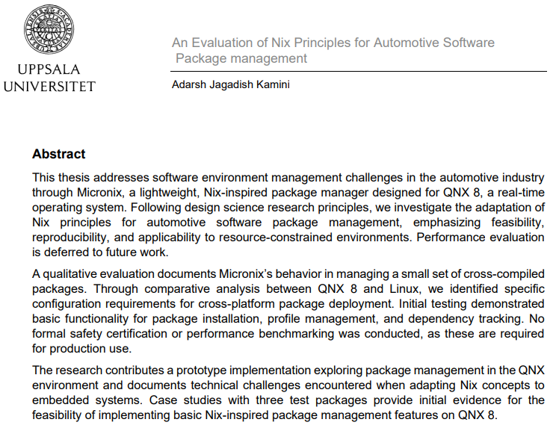
Micronix — Uppsala University

Slide 7
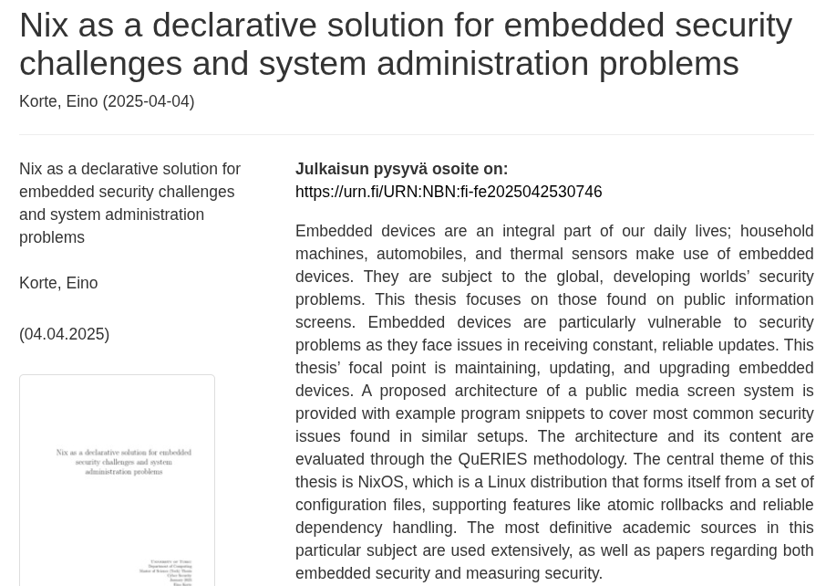
Nix as a solution for embedded security — University of Turku

Slide 8
Novelty
Due to the relative youth of NixOS in embedded systems, there are still many areas to explore
Current research in Embedded NixOS focus on:
  Reproducing typical firmware with NixOS as the build system
  Reimplementing Nix-inspired systems on other OSes (BSD, RTOS, etc.)
There is not yet a rehosting framework for firmware images with NixOS as the core operating system
  Unique userspace (FHS Non-Compliance, Nix Store, etc.) mean we can’t throw just any Linux framework at it.

Slide 9

nixWRehosT: Data Sources
NixOS-based firmware is more popular in industry than academia:
  Jetpack-NixOS — Firmware images for Nvidia Jetson by Anduril
  NixWRT — Community firmware images for routers
  NixOS-Baloo — PoC based on Android/Chromebook boards
Diverse set of hardware that nixWRehosT can evaluate
  Supports community interests!
  At least that was the thought...

Slide 10
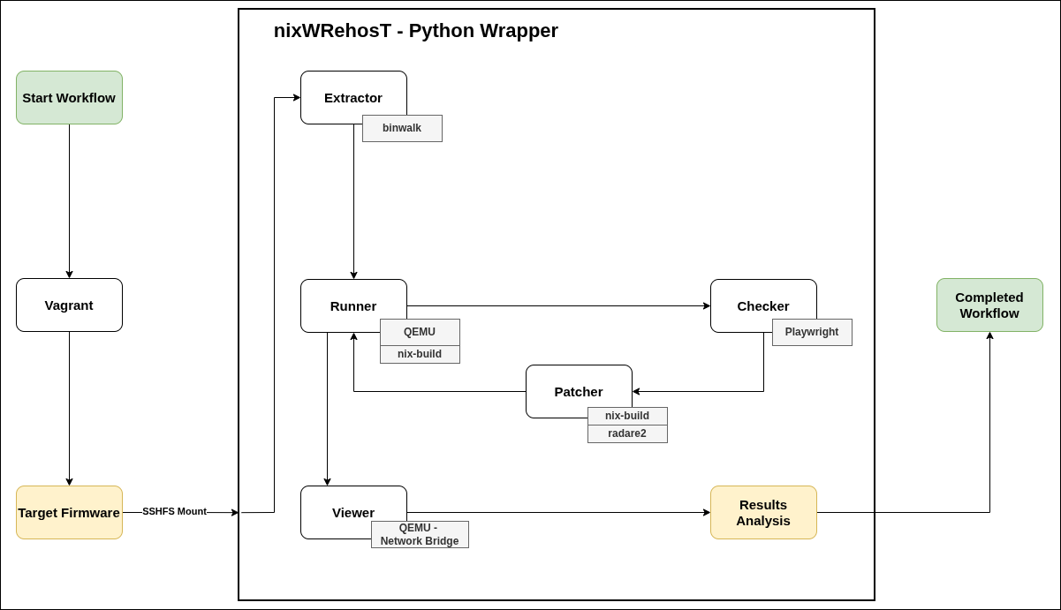
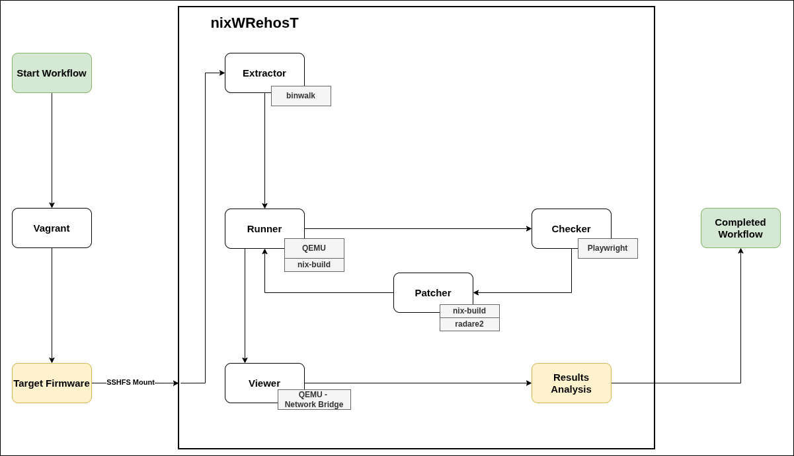
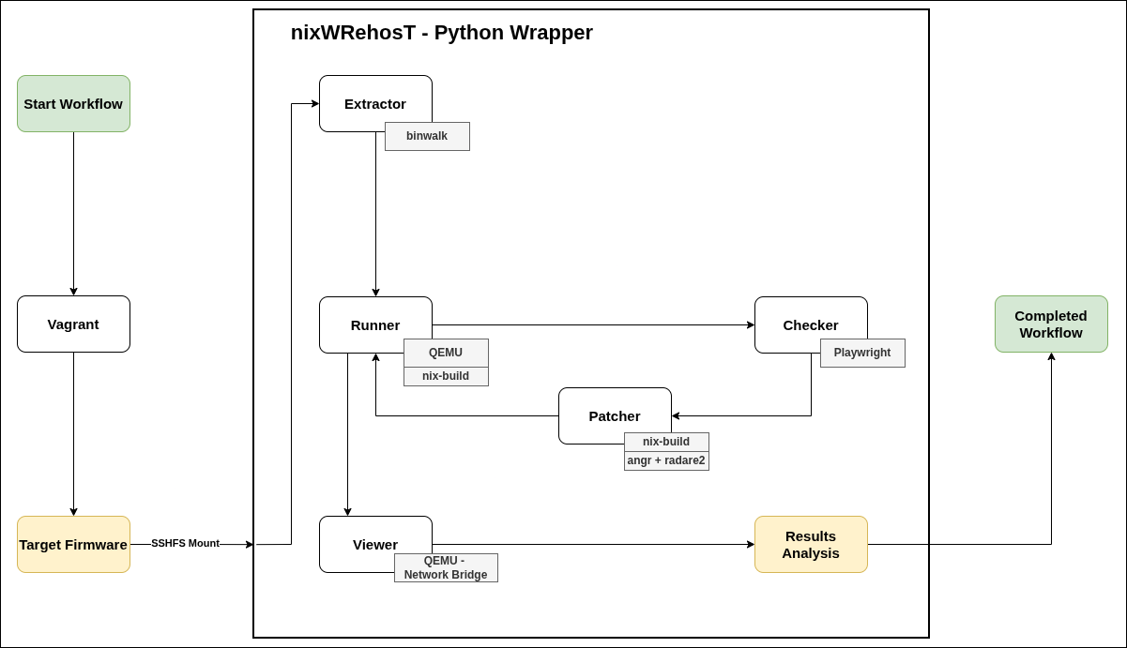
nixWRehosT: Proposed Architecture

Slide 11
nixWRehosT: Where It’s Actually At

Slide 12
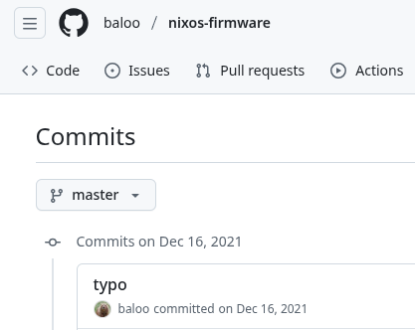
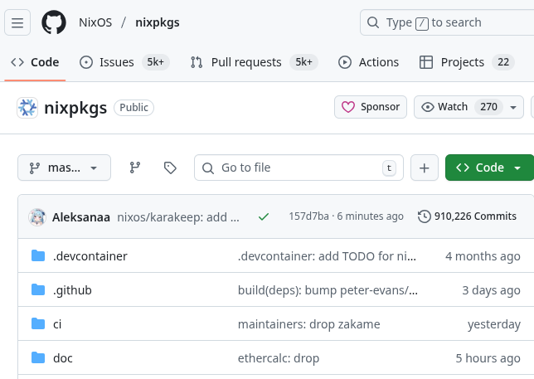
Roadblocks This Semester
The most basic thing — Compiling Test Images...
  Most non-corporate, community images turned out to be abandonware :(
  Anduril doesn’t release all their work...
  In the end, not many firmware images to experiment with

Slide 13
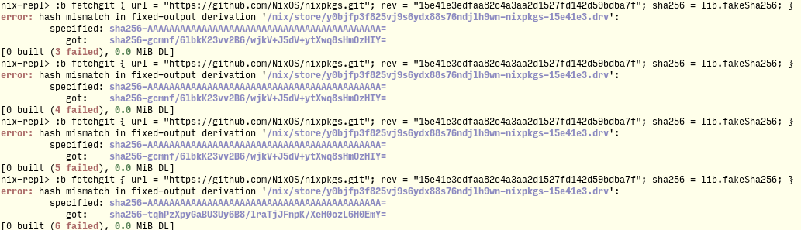
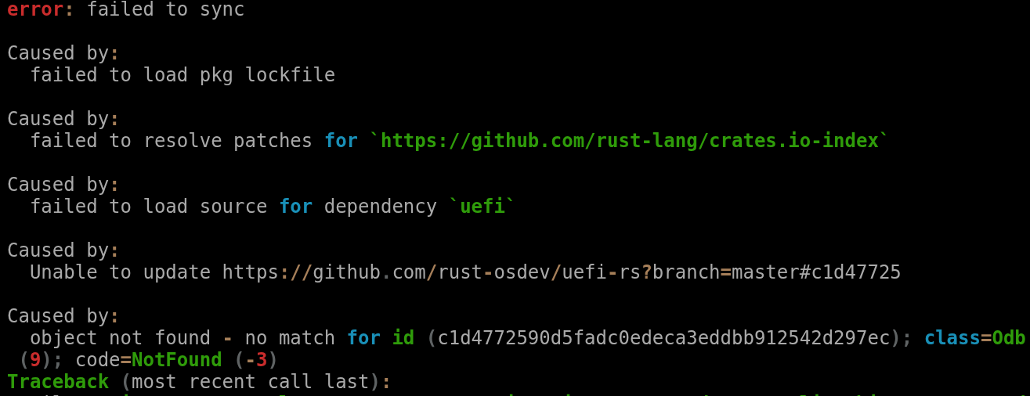
Roadblocks This Semester
Direct and indirect dependencies
  Nixpkgs = Strict version hashing
  3rd-Party Rust Crate = No longer available

Slide 14
Live Demo

Slide 15
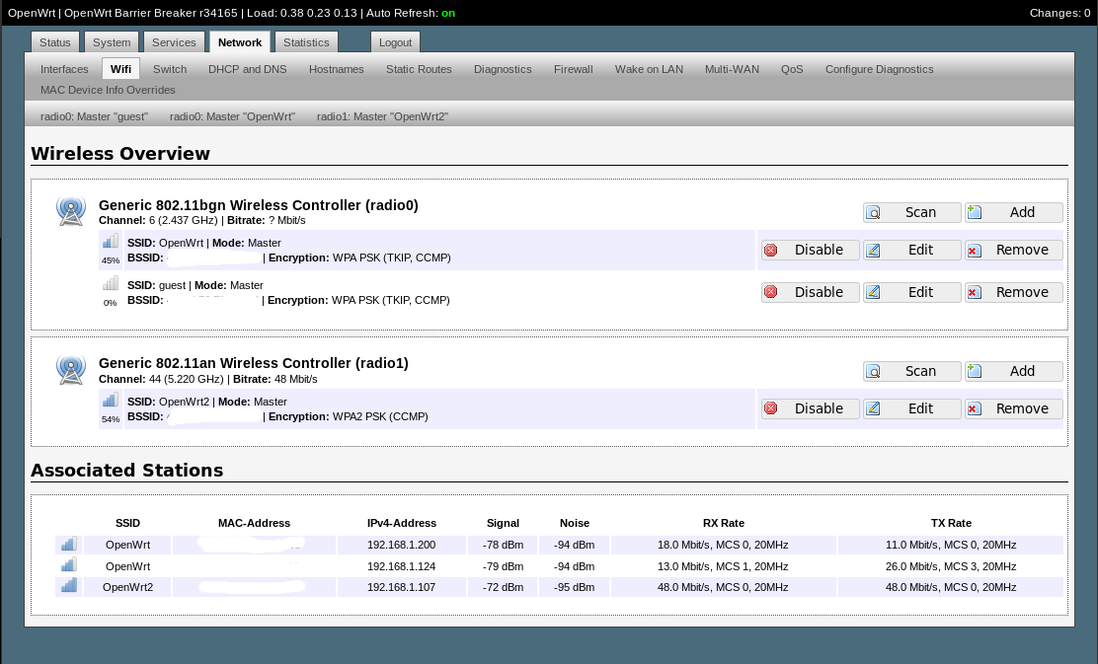
Next Steps
Fidelity Stretch Goal: Get OpenWRT Web Interface working
Successfully debug all NixOS images that failed compiling
  We need more images for unit tests :)
Long-Term: Expand nixWRehosT into a fully automated system
Independent study w/ advisor? 🤔
Access the repo with:
  https://github.com/winstonwumbo/cse-597-nixWRehosT

Slide 16
References
[1] https://github.com/tuhhosg/reupnix
[2] https://uu.diva-portal.org/smash/get/diva2:2002562/FULLTEXT01.pdf
[3]https://www.utupub.fi/bitstream/handle/10024/180653/Korte_Eino_Thesis.pdf
[4] https://github.com/anduril/jetpack-nixos
[5] https://github.com/vkleen/nixwrt

Slide 17
References
[6]https://www.usenix.org/conference/usenixsecurity23/presentation/tay
[7] https://www.ndss-symposium.org/ndss-paper/auto-draft-634/
[8]https://www.usenix.org/conference/usenixsecurity24/presentation/angelakopoulos

